Slide 1

ITSM Predictive SLA Breach

Slide 2
Problem Statement
IT service teams often fail to meet Service Level Agreements (SLAs) due to incorrect ticket prioritization and inefficient resource allocation. These SLA breaches result in customer dissatisfaction, contractual penalties, and increased operational costs. Currently, teams lack a reliable, data-driven method to identify tickets at high risk of SLA breach early in the lifecycle, limiting their ability to intervene proactively.
Our pipeline addresses this challenge by transforming raw ITSM ticket data into actionable SLA breach predictions. This enables teams to prioritize tickets more effectively, allocate resources efficiently, and reduce the frequency and impact of SLA violations.

Slide 3
Predicting Ticket SLA Breach & Recommendations
Machine learning based classification pipeline that analyzes historical ITSM ticket data to predict whether a new ticket is likely to breach its SLA. By learning from patterns in ticket metadata such as timestamps, categories, and resolution history the system identifies high-risk tickets early, empowering IT operations to take timely, data-driven actions to prevent service disruptions and SLA violations.

Slide 4
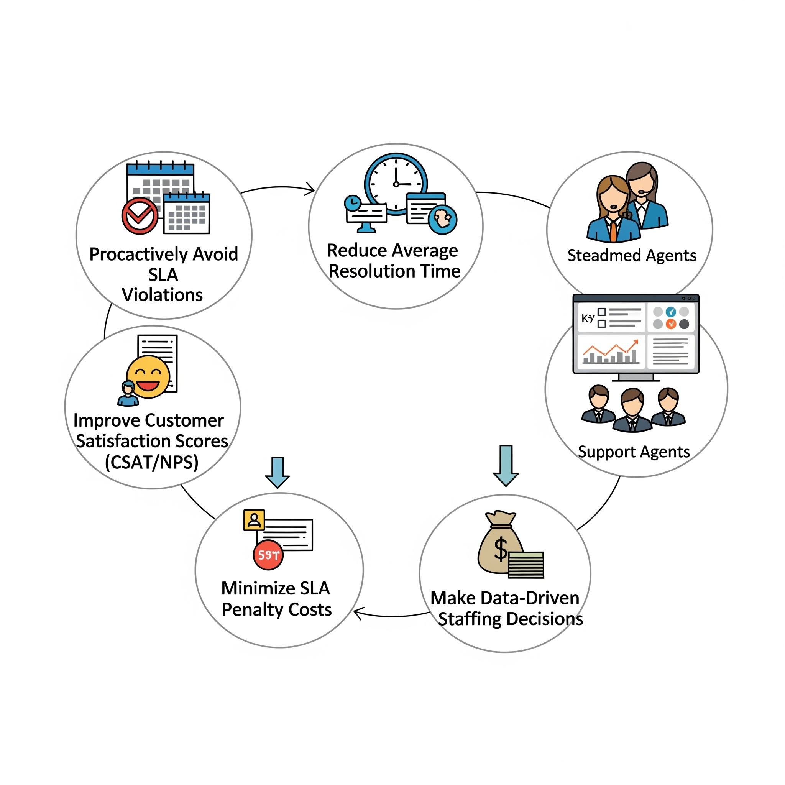
What impact will this have?

Slide 5
Data Processing layer
Time & Load Metrics (Engineered)
Fields | Description
MTTR (hours) | Average resolve time
MTBF (days) | Average time between fails
SLA Compliance Flag | Resolved in SLA? (Y/N)
Temporal Features | Hour, weekday, etc.
Ticket Metadata
Customer & Contract Info
Field | Description
Ticket ID | Unique ticket ID
Created At / Created Date | Ticket creation time
Responded At / Resolved At | Technician timestamps
Status | Open, Closed, etc.
Priority | High, Medium, Low
SLA Breach | Y/N (Target label)
Reopened Count | Number of reopenings
Response Time (minutes) | Time to first response
Resolution Time (hours) | Time to resolution
Ticket Source | Email, portal, etc.
Ticket Type | Incident, Request, etc.
Impact Level | Severity of impact
Field | Description
Customer ID | Unique customer ID
Customer Segment | Enterprise, SMB, etc.
Contract Type | SLA plan (Gold, etc.)
Region / Business Unit | Geo & org info
Service SLA Target | Expected resolution
Penalty Cost | Penalty for breach
CSAT Score | Satisfaction score
Change / Problem Management Linking
Field | Description
Change Request Linked | Y/N
Problem Ticket Linked | Linked to known issue
Technician Logs
Field | Description
Assigned Technician ID | ID of technician
Technician Skill Level | Skill level rating
Team ID / Escalation Team ID | Assigned teams
Root Cause & Escalation Info
Field | Description
Root Cause Category | Network, App, etc.
Escalation Level | Escalation depth

Slide 6
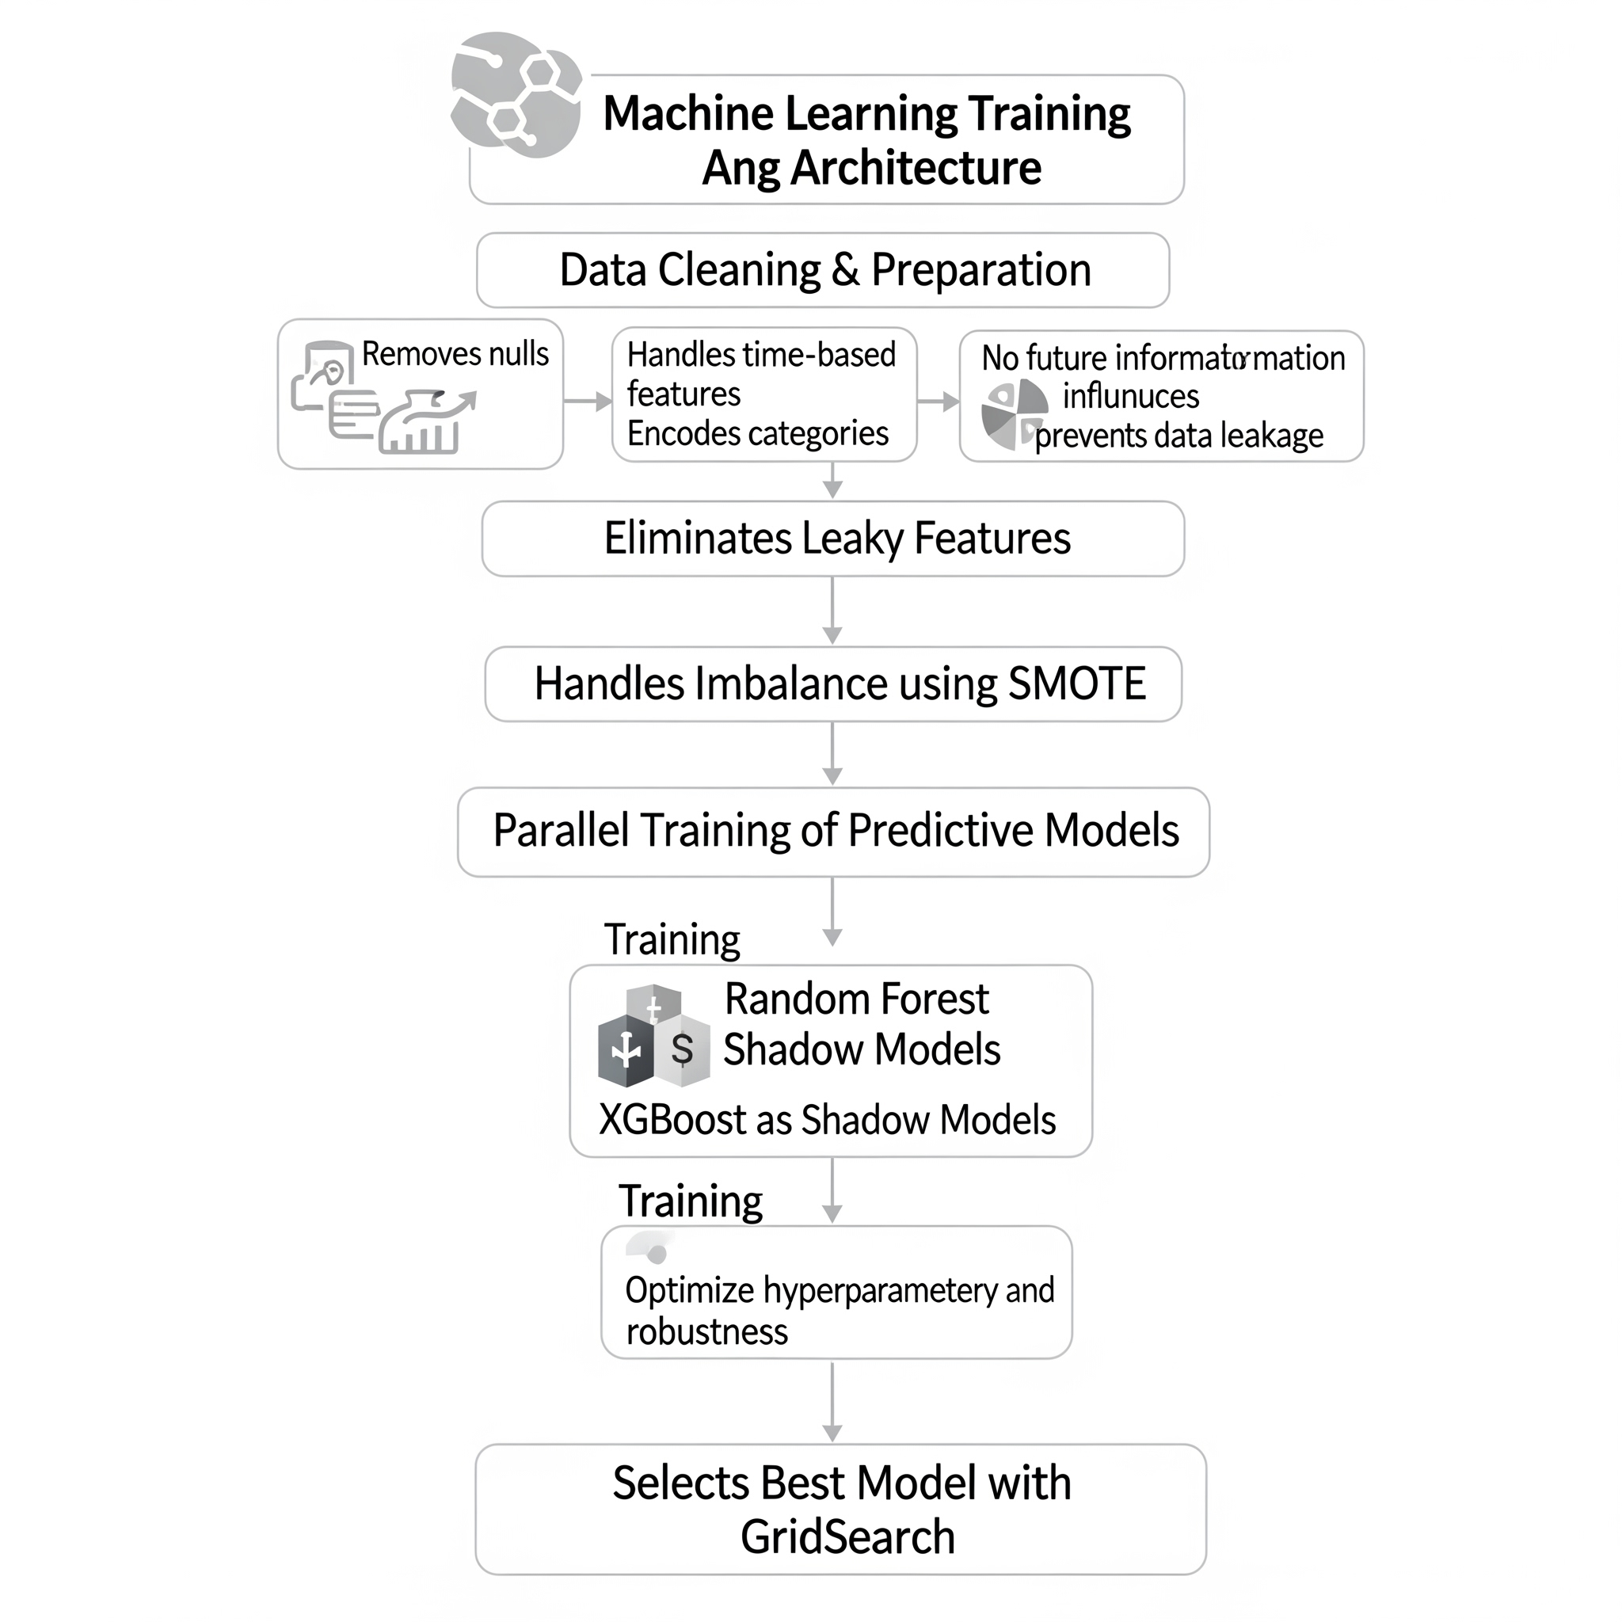
SLA Breach Training pipeline
Data Cleaning & Preparation: This is the initial crucial step where raw data is transformed into a clean and usable format for model training.
Removes nulls: Missing values in the dataset are identified and handled (e.g., by removal or imputation) to prevent errors or biases in the model.
Handles time-based features: Data points that include time information are processed appropriately. This might involve extracting features like day of the week, month, or year, or creating lag features.
Encodes categories: Categorical data (like "color" or "city") are converted into a numerical format that machine learning models can understand (e.g., One-Hot Encoding, Label Encoding).
Eliminates Leaky Features:
This step is critical for preventing data leakage. Data leakage occurs when information from outside the training dataset is used to create the model, leading to overly optimistic performance estimates. Here, it specifically ensures the model doesn't "cheat" by using future information that wouldn't be available at the time of prediction (e.g., using a target variable's future value as a feature).
Handles Imbalance using SMOTE:
SMOTE (Synthetic Minority Over-sampling Technique) is a technique used to address imbalanced datasets. In your context, it's used to boost the model's ability to learn from "rare SLA breaches." This means that if one class (e.g., "SLA breach") is significantly underrepresented compared to another (e.g., "no SLA breach"), SMOTE creates synthetic samples of the minority class to balance the dataset, preventing the model from ignoring the rare but important cases.
Parallel Training of Predictive Models:
This section indicates that multiple predictive models are trained simultaneously.
Random Forest and XGBoost are two powerful ensemble machine learning algorithms commonly used for prediction tasks. Training them in parallel allows for a comparative analysis of their performance. The diagram shows them as "Shadow Models," implying they are trained alongside each other for evaluation before selecting the best one.
Selects Best Model with GridSearch:
GridSearch (specifically GridSearchCV) is a hyperparameter tuning technique. After training multiple models (like Random Forest and XGBoost), GridSearch systematically works through multiple combinations of hyperparameter values to find the optimal set that yields the best model performance (e.g., highest accuracy, lowest error) and ensures robustness. This final step selects the most accurate and robust model for deployment.
Accuracy – For now accuracy is almost 90 percent for rf and 87 percent for XG our cases but we will consider recall cases as prominent identifier

Slide 7
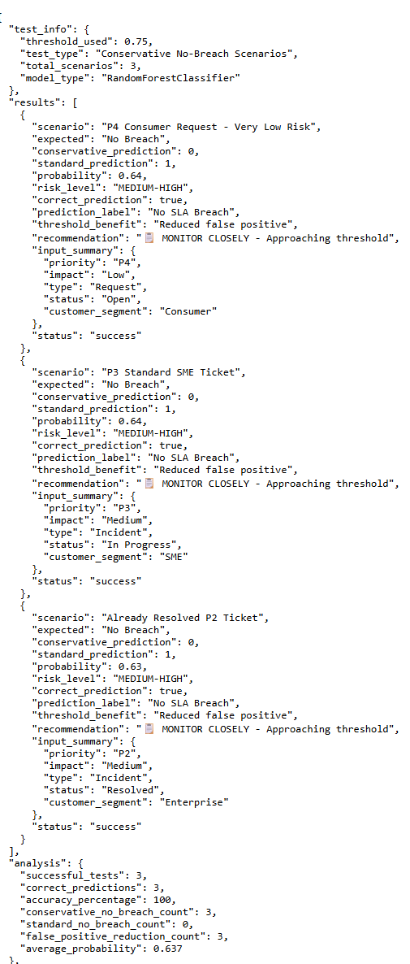
Inference Pipeline
Use Flask Api to access the model to get the inference pipeline result to get the sla breach result
Threshold Used: The probability value that determines the classification boundary (e.g., above this, it's one class; below, it's another).
Total Scenarios: The number of distinct test cases or situations evaluated by the model.
Correct Prediction (Individual): Indicates if the model's prediction for a specific scenario matched the actual outcome.
Probability (Individual): The model's confidence score for its prediction in a given scenario.
Risk Level: The categorized level of risk assigned to a scenario based on the model's output (e.g., "MEDIUM-HIGH").
Successful Tests: The total number of scenarios that were processed completely without errors.
Correct Predictions (Overall): The cumulative count of accurate predictions made by the model across all scenarios.
Accuracy Percentage: The overall proportion of correct predictions out of all successful tests, expressed as a percentage.
Conservative No-Breach Count: The number of times the model, under a conservative approach, predicted that no breach would occur.
Standard No-Breach Count: The number of times the model, under a standard approach, predicted that no breach would occur.
False Positive Reduction Count: The number of instances where the model's strategy successfully reduced false positive errors.
Average Probability: The mean of all predicted probabilities across the tested scenarios.

Slide 8
Recommender Training
Data Collection
Historical tickets with:
Ticket metadata (priority, category, timestamp, description, etc.)
Technician assignments
SLA status (breached or not)
Resolution time and success rate
Metric: NDCG@k — how well the top-k recommendations align with actual top choices
Feature Engineering
Technician performance history (SLA adherence, backlog, domain expertise)
Ticket complexity metrics
Technician–ticket pairwise features (e.g. skill match, last assigned, etc.)
Model Training
Learning-to-rank algorithm (e.g., LambdaRank in LightGBM)
Input: technician-ticket pairs
Output: relevance score (suitability of tech for the ticket)

Slide 9
Inference Pipeline
Lightweight Flask microservice (/recommend) deployed
Accepts a new ticket JSON payload.
Internally:
Fetches available technicians.
Generates features for each technician-ticket pair.
Uses model to rank all candidates.
Returns the top N recommended technicians sorted by relevance score.

